Slide 1
USE CASE DIAGRAM
In the Unified Modeling Language (UML), a use case diagram can summarize the details of your system's users (also known as actors) and their interactions with the system. To build one, you'll use a set of specialized symbols and connectors

Slide 2
Use Cases
Use case diagrams describe what a system does from the standpoint of an external observer. The emphasis is on what a system does rather than how.
Use case diagrams are closely connected to scenarios. A scenario is an example of what happens when someone interacts with the system.

Slide 3
What is a Use Case
A formal way of representing how a business system interacts with its environment
Illustrates the activities that are performed by the users of the system
A scenario-based technique in the UML
A sequence of actions a system performs that yields a valuable result for a particular actor.

Slide 4
Use case diagram components To answer the question, "What is a use case diagram?" you need to first understand its building blocks. Common components include:
Actors: The users that interact with a system. An actor can be a person, an organization, or an outside system that interacts with your application or system. They must be external objects that produce or consume data.
System: A specific sequence of actions and interactions between actors and the system. A system may also be referred to as a scenario.
Goals: The end result of most use cases. A successful diagram should describe the activities and variants used to reach the goal.

Slide 5
Use Cases
Here is a scenario for a medical clinic.
A patient calls the clinic to make an appointment for a yearly checkup. The receptionist finds the nearest empty time slot in the appointment book and schedules the appointment for that time slot. "
We want to write a use case for this scenario.
Remember: A use case is a summary of scenarios for a single task or goal.

Slide 6
Use Cases
Step 1 Identify the actors
As we read the scenario, define those people or systems that are going to interact with the scenario.
A patient calls the clinic to make an appointment for a yearly checkup. The receptionist finds the nearest empty time slot in the appointment book and schedules the appointment for that time slot. "

Slide 7
Questions for Identifying People Actors
Who is interested in the scenario/system?
Where in the organization is the scenario/system be used?
Who will benefit from the use of the scenario/system?
Who will supply the scenario/system with this information, use this information, and remove this information?
Does one person play several different roles?
Do several people play the same role?
Notes:
Actors
7) Does one person play several different roles?
May have an actor for each role
8) Do several people play the same role?
Only use one actor per role (no matter how many people play that role)
Identifying actors is an iterative process
Defining how an actor interacts with the system may clarify whether there are duplicate actors or not

Slide 8
Questions for Identifying Other Actors
What other entity is interested in the scenario/system?
What other entity will supply the scenario/system with this information, use this information, and remove this information?
Does the system use an external resource?
Does the system interact with a legacy system?
Notes:
Actors
7) Does one person play several different roles?
May have an actor for each role
8) Do several people play the same role?
Only use one actor per role (no matter how many people play that role)
Identifying actors is an iterative process
Defining how an actor interacts with the system may clarify whether there are duplicate actors or not

Slide 9
Actors
An Actor is outside or external the system.
It can be a:
Human
Peripheral device (hardware)
External system or subsystem
Time or time-based event
Represented by stick figure
Notes:
Actors
Are NOT a part of the system (external to the system)
A single actor may represent multiple physical users
Whether human or not, represented by stick figure
MUST label stick figure with the name of the actor

Slide 10
Use Cases
A use case is a summary of scenarios for a single task or goal.
An actor is who or what initiates the events involved in the task of the use case. Actors are simply roles that people or objects play.
So as we read our scenario, what or who is the actor????

Slide 11

So as we read our scenario, what or who is the actor????
A patient calls the clinic to make an appointment for a yearly checkup. The receptionist finds the nearest empty time slot in the appointment book and schedules the appointment for that time slot. "
The actor is a Patient.

Slide 12
Use Cases
The use case is a summary of scenarios for a single task or goal.
So What is the Use Case????
The Use Case is Make Appointment.
It is a use case for the medical clinic.

Slide 13

Use Cases
The picture below is a Make Appointment use case for the medical clinic.
The actor is a Patient. The connection between actor and use case is a communication association (or communication for short).

Slide 14
Use Case Components
The use case has three components.
The (1)use case task referred to as the use case that represents a feature needed in a software system.
The (2)actor(s) who trigger the use case to activate.
The (3)communication line to show how the actors communicate with the use case.

Slide 15
Use Case
Each use case in a use case diagram describes one and only one function in which users interact with the system
May contain several “paths” that a user can take while interacting with the system
Each path is referred to as a scenario
Notes:
Use Case
In reading a use case, you should not be able to tell if an activity is computerized or manual
Used to document the current system (AS-IS system) or the new system being developed (TO-BE system)
Communicates at a high level what the system needs to do
Captures the typical interaction of the system with the system’s users
Logical model
Physical details are defined during the design phase

Slide 16
Use Case
Labelled using a descriptive verb-noun phrase
Represented by an oval
Make
Appointment
Notes:
Use case: A use case in a use case diagram is a visual representation of a distinct business functionality in a system. The key term here is "distinct business functionality." To choose a business process as a likely candidate for modeling as a use case, you need to ensure that the business process is discrete in nature. As the first step in identifying use cases, you should list the discrete business functions in your problem statement. Each of these business functions can be classified as a potential use case. Remember that identifying use cases is a discovery rather than a creation. As business functionality becomes clearer, the underlying use cases become more easily evident. A use case is shown as an ellipse in a use case diagram Depicted by an oval
MUST label the oval with the name of the use case

Slide 17
Use Case - Actor
Labelled using a descriptive noun or phrase
Represented by a stick character
Notes:
Actors: An actor portrays any entity (or entities) that performs certain roles in a given system. The different roles the actor represents are the actual business roles of users in a given system. An actor in a use case diagram interacts with a use case. For example, for modeling a banking application, a customer entity represents an actor in the application. Similarly, the person who provides service at the counter is also an actor. But it is up to you to consider what actors make an impact on the functionality that you want to model. If an entity does not affect a certain piece of functionality that you are modeling, it makes no sense to represent it as an actor. An actor is shown as a stick figure in a use case diagram depicted "outside" the system boundary, as shown in Make Appointment figure.
Depicted by an oval
MUST label the oval with the name of the use case
To identify an actor, search in the problem statement for business terms that portray roles in the system. For example, in the statement "patients visit the doctor in the clinic for medical tests," "doctor" and "patients" are the business roles and can be easily identified as actors in the system.

Slide 18
Use Case - Relationships
Relationships
Represent communication between actor and use case
Depicted by line or double-headed arrow line
Also called association relationship
Make
Appointment
Notes:
Use Case Relationship
Association relationship
May exist between actor and a use case
Often referred to as a communicate association
Navigable in both directions (actor to use case and use case to actor)
Some use just a line
Others use a double-headed arrowhead
Navigable in only one direction (actor to use case OR use case to actor)
Use a arrowhead where arrowhead denotes the direction of communication
Navigation direction of an association represents who is initiating the communication
Multiplicity
Not consistency shown on all use-case diagrams (Some do; some don’t)

Slide 19
Use Case - Relationships
Boundary
A boundary rectangle is placed around the perimeter of the system to show how the actors communicate with the system.
Make
Appointment
Notes:
System boundary: A system boundary defines the scope of what a system will be. A system cannot have infinite functionality. So, it follows that use cases also need to have definitive limits defined. A system boundary of a use case diagram defines the limits of the system. The system boundary is shown as a rectangle spanning all the use cases in the system.
Other use cases in this lecture also show the system boundary of the clinic application. The use cases of this system are enclosed in a rectangle. Note that the actors in the system are outside the system boundary.
The system boundary is potentially the entire system as defined in the problem statement. But this is not always the case. For large and complex systems, each of the modules may be the system boundary. For example, for an ERP system for an organization, each of the modules such as personnel, payroll, accounting, and so forth, can form the system boundary for use cases specific to each of these business functions. The entire system can span all of these modules depicting the overall system boundary.

Slide 20
Use Case Diagram
Other Types of Relationships for Use Cases
Generalization
Include
Extend
Notes:
Inheritance

Slide 21
Generalization Relationship - Inheritance
Represented by a line and a hollow arrow, From child to parent
A use case generalization shows that one use case is simply a special kind of another.
A clinic may have a use case such as Pay Bill which would be a parent use case and Bill Insurance which is the child.
A child can be substituted for its parent whenever necessary.
Generalization appears as a line with a triangular arrow head toward the parent use case.
Child use case
Parent use case

Slide 22
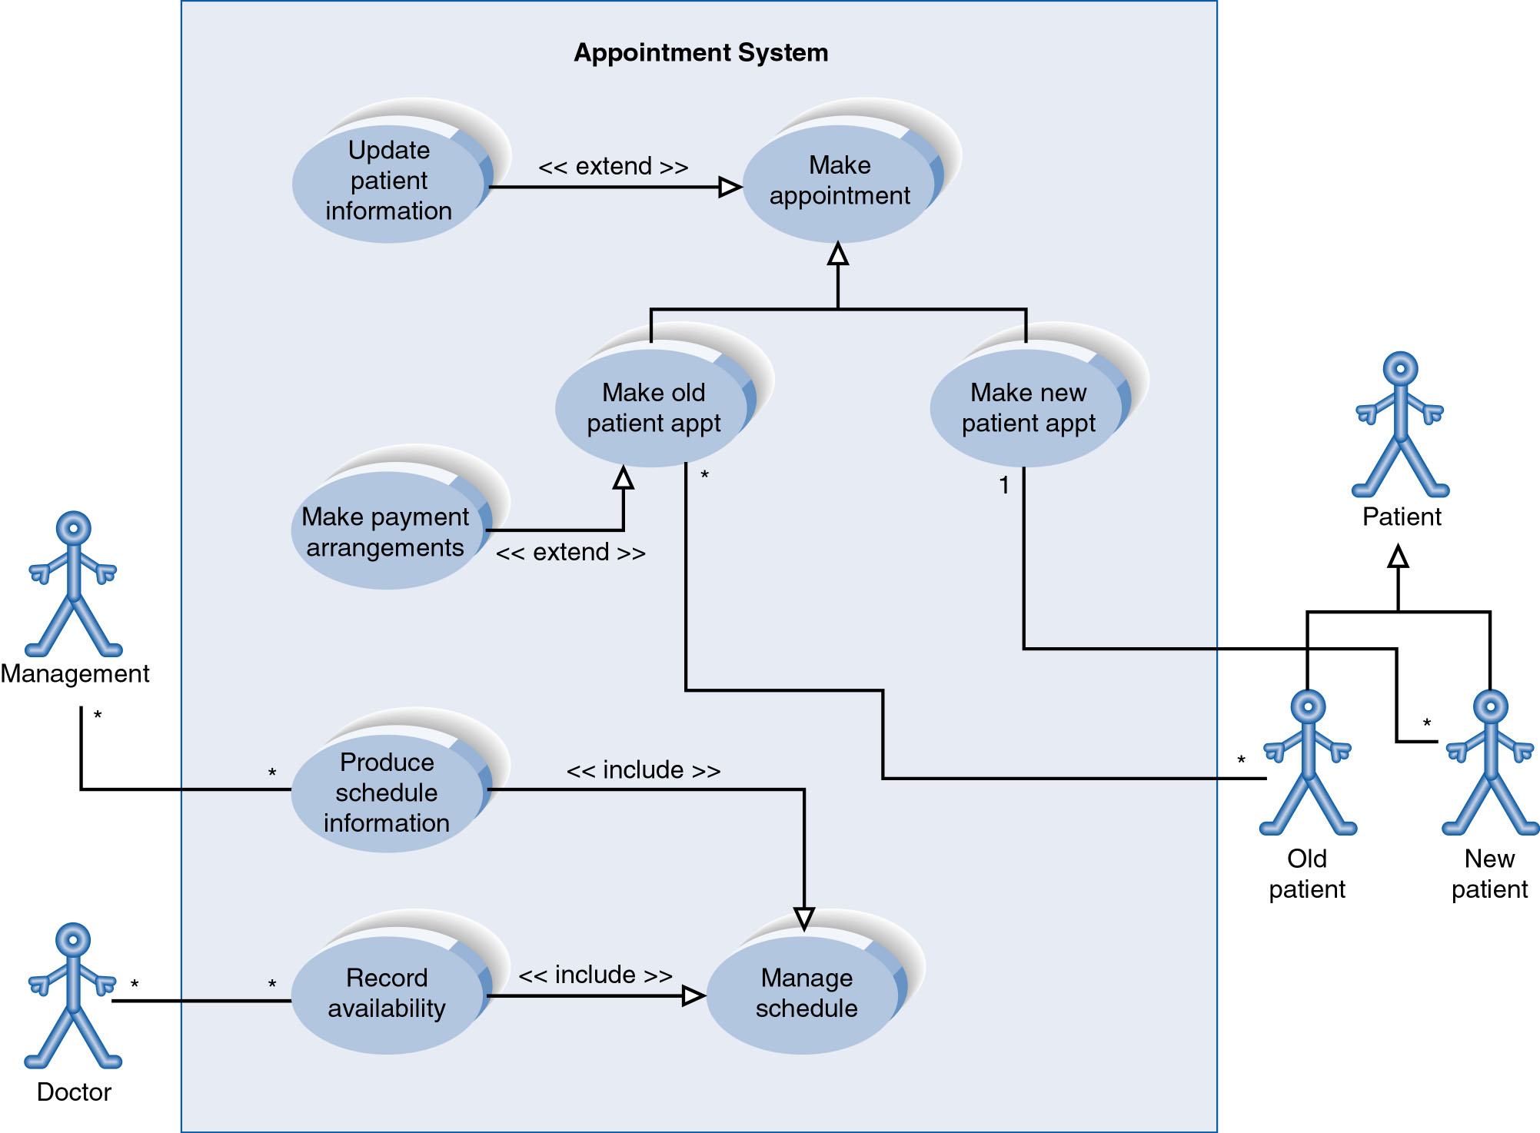
Example of Relationships
Notes:
System Boundary
Use cases are enclosed within a system boundary
a box that represents the system and clearly delineates what parts of the diagram are external or internal to it
Name of the system can appear inside or on top of the box

Slide 23
Use Case Diagram
Include Relationship
Represents the inclusion of the functionality of one use case within another
Arrow is drawn from the base use case to the used use case
Write << include >> above arrowhead line
Notes:
Include relationship
Notice that ONLY between use cases (not between actors)
MANDATORY functional
Multiple use cases may share pieces of the same functionality
Rather than have duplicate functionality in several use cases
Put shared functionality in one use case and show relationship between it and other use cases that “uses” its functionality
Depicted by arrowhead with word “<<include>>” above it
Include relationships factor use cases into additional ones.
Includes are especially helpful when the same use case can be factored out of two different use cases.
If a clinic had a cases of Make Appointment and Request Medication.
Both might include Check Patient Record as a subtask.
Both would include a call to the use case Check Patient Record.
We don’t want to write it twice we simply want to include in as a call from both.
In the diagram,
include notation is a dotted line beginning at base use case ending with an arrows pointing to the include use case.
The dotted line is labeled <<include>>.

Slide 24
Use Case Diagram
Extend relationship
Represents the extension of the use case to include optional functionality
Arrow is drawn from the extension use case to the base use case
Write << extend >> above arrowhead line
Notes:
Use Case Relationship
Extend relationship
Used to show optional behavior (behavior that is run only under certain circumstances)
Depicted by arrowhead with word “<<extend>>” above it
An extend relationship indicates that one use case is a variation of another.
This is often used when much of the same code may be in both only one extends the functionality somewhat.
A typical example is a add record to the database and modify that record.
So an add student is similar to a modify student so I may reuse some of the code.
Extend notation is a dotted line, labeled <<extend>>, and with an arrow toward the base case.
The extension point, which determines when the extended case is appropriate, is written inside the base case.

Slide 25
Example of Relationships
Notes:
System Boundary
Use cases are enclosed within a system boundary
a box that represents the system and clearly delineates what parts of the diagram are external or internal to it
Name of the system can appear inside or on top of the box

Slide 26
Use Case Diagram Uses
A major process performed by the system that benefits an actor(s) in some way
Models a dialogue between an actor and the system
Represents the functionality provided by the system
Notes:
Use Case
Represent the user functionality (not system functionality)

Slide 27
An effective use case diagram can help your team discuss and represent:
Scenarios in which your system or application interacts with people, organizations, or external systems
Goals that your system or application helps those entities (known as actors) achieve
The scope of your system

